Slide 1
6CS005 High Performance Computing
Lecture 3
Parallel Computing

Slide 2
Contents
Parallel Computing Overview
Key Components of Parallel Computing
Serial and Parallel Computing
Sequential and Parallel Programming
Relationship Between Tasks
Classification of Computing Systems: Flynn’s Classification
Enhancing Computational Efficiency: Key Objectives
Classification of Computer Architecture by Memory Organization
Homogeneous Computing
Homogeneous Architecture

Slide 3
Parallel Computing Overview
Primary goal of parallel computing is to improve the speed of computation by performing many calculations simultaneously
Definition:
  Calculation perspective: Large problems are divided into smaller tasks, solved concurrently
  Programmer perspective: Concurrent tasks are mapped onto multiple computing resources (cores or computers) for parallel execution
Parallel computing involves the close integration of hardware and software to achieve efficient performance in solving complex problems

Slide 4
Key Components of Parallel Computing
Hardware (Computer Architecture)
  Focuses on supporting parallelism at the architectural level
Software (Parallel Programing)
  Focuses on solving a problem concurrently by fully using the computational power of the computer architecture
Note: To enable parallel execution in software, the hardware must support concurrent execution of multiple processes or threads.

Slide 5
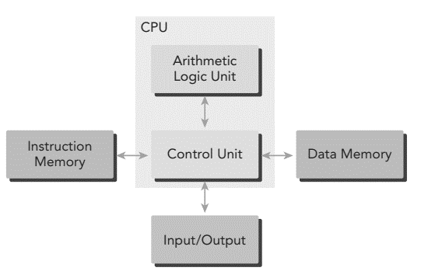
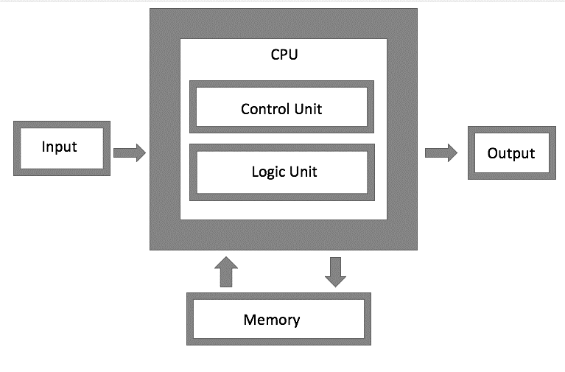
Hardware (Computer Architecture)
Most modern processors utilize the Harvard architecture instead of the Von Neumann architecture
Harvard Architecture
Von Neuman Architecture

Slide 6
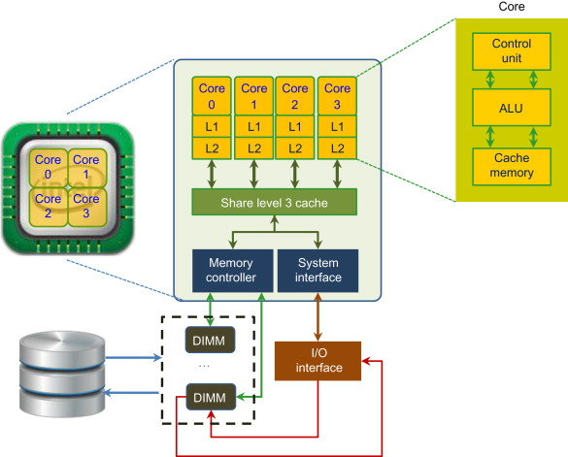
Contd…
CPU(Core):
  The primary component for processing tasks
  Early computers operated with a single core on a chip, known as uniprocessor
  Modern chip design integrates multiple cores(individual processing unit within a processor) into a single processor, referred to as multicore architecture.
  This design supports parallelism, allowing multiple tasks to be processed simultaneously
  Example Quad-core processor(Intel Core i7-7700 or AMD Ryzen 7, has four cores (Core 0, Core 1, Core 2, Core 3) that can run separate thread simultaneously
Core Processor Architecture
DIMM: Dual Inline Memory Module are essential components in core processor architecture,
providing the necessary memory resources for efficient processing, types or volatile memory
Level 3 Cache: Type of cache memory used in computer architecture to improve the performance
of the CPU by storing frequently accessed data and instructions

Slide 7
Can a quad-core processor handle four tasks at the same time?
The ability of a quad-core processor to handle four tasks simultaneously is not automatic; it depends on several factors:
Multithreading:
  Single-Threaded Applications:
    If an application is single-threaded, it can only use one core at a time, even on a quad-core processor, activating only one core for that task.
  Multi-Threaded Applications:
    Multi-threaded applications can utilize multiple cores by splitting workloads into separate threads, enabling concurrent execution. A well-optimized multi-threaded application can effectively use all four cores of a quad-core processor.
Operating System and Task Management
  The operating system manages tasks and allocates them to available cores, distributing processes or threads based on their availability and workload.

Slide 8
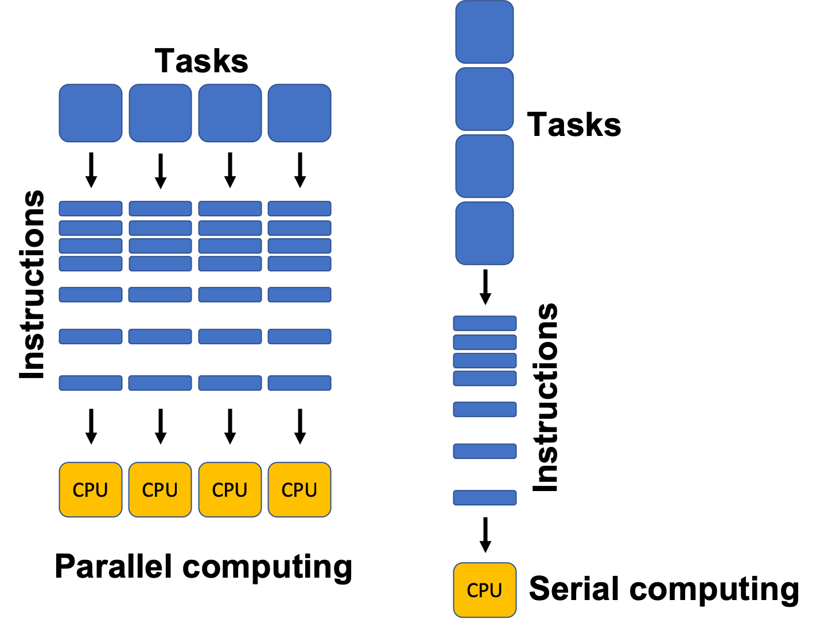
Serial and Parallel Computing

Slide 9
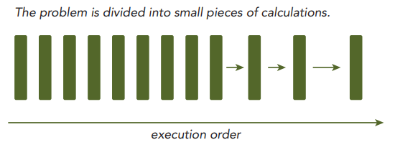
Sequential and Parallel Programming
Sequential Programming
  Involves writing code where tasks are executed one after the other
  Each calculation or instruction waits for the previous one to complete

Slide 10
Relationship Between Tasks
Based on execution constraints:
Sequential/Dependent Tasks:
  Dependent tasks are tasks that have a direct relationship where the outcome of one task is necessary for the next task to execute
Concurrent/Independent Tasks:
  Independent tasks are tasks that can operate on their own without needing to wait for the results of other tasks
Understanding data dependencies is crucial for implementing parallel algorithms, as they are major barriers to achieving parallelism
Often, multiple independent chains of dependent tasks provide the best opportunities for effective parallelization.

Slide 11
Contd…
Multiple independent chains of dependent tasks
Example:
Chain of dependent task:
  Tas1🡺Task2🡺Task3
  In this chain, Task2 can only start once Tasks is finished, and Task3 can only start after Task2 is completed
Multiple independent chains:
  Chain 1: TaskA1🡺TaskA2🡺TaskA3
  Chain 2: TaskB1🡺TaskB2🡺TaskB3
  Here, Chain 1 and Chain 2 can run concurrently because the do not share any dependencies

Slide 12
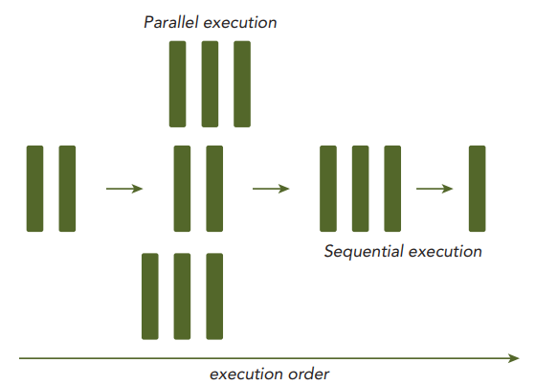
Contd…
Parallel Programming
  Involves writing code that enables multiple tasks to be executed concurrently, often by splitting a problem into smaller tasks
  Takes advantage of multi-core or distributed systems to improve performance

Slide 13
Parallelism Overview
Parallelism is essential in modern computing
It improves performance by allowing multiple tasks to run at the same time
Types or Parallelism:
  Task Parallelism
    Multiple independent tasks or function running at once
    Tasks or function are distributed across different CPU cores
    Eg: Database Server(Multiple user can query and update data simultaneously), Web Browsers(Manage different browser tabs), Operating Systems(Run multiple programs at the same time)
  Data Parallelism
    Many pieces of data processed simultaneously
    Data is divided among multiple cores for faster processing
    Eg: Image Processing: Each pixel can be processed independently with the same filter operation such as blur, sharpen, or edge detection

Slide 14
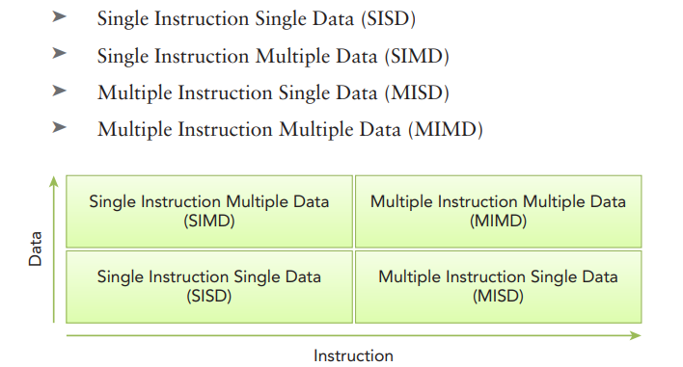
Classification of Computing System: Flynn's Taxonomy
Computing systems can be classified into four major categories based on the number of instruction and data streams they can process simultaneously
Instruction Stream: A sequence of instructions executed by a processor
Data Stream: A sequence of data required by an instruction stream

Slide 15
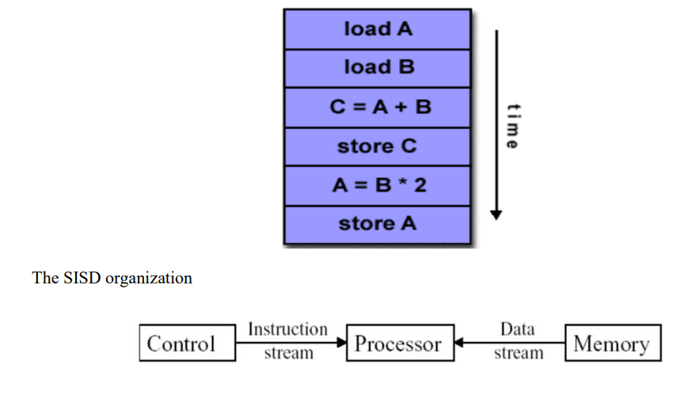
Contd…
SISD
  Traditional serial architecture with a single core
  At any time, only one instruction stream is executed, and operations are performed on one data stream
  Examples: most PCs, single CPU workstations and mainframes

Slide 16
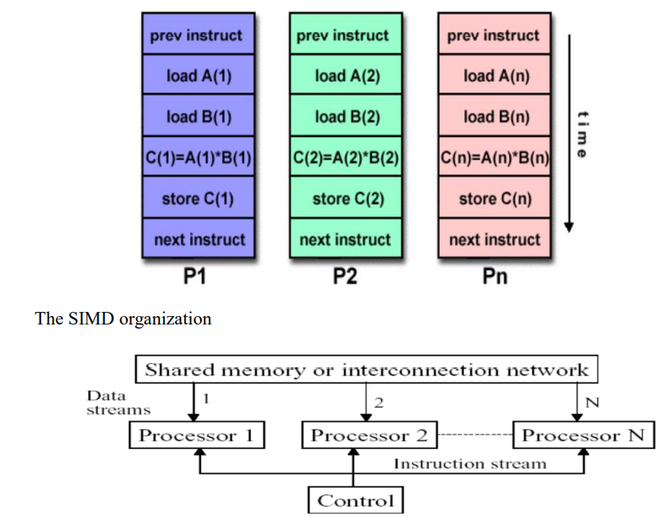
Contd…
SIMD
  A type of parallel computer
  Best suited for specialized problems such as image processing and vector computation

Slide 17
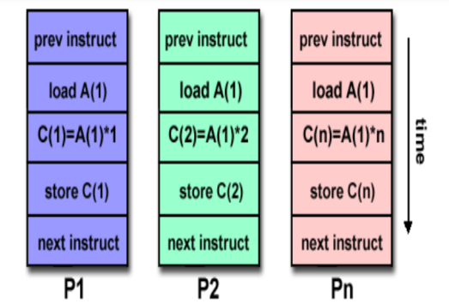
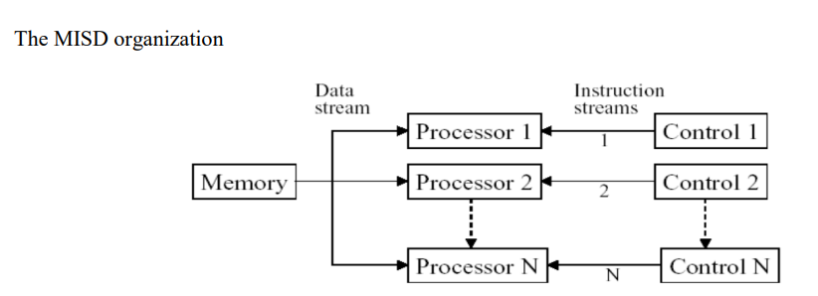
Contd…
MISD
  Uncommon architecture
  Each core operates on the same data stream but uses different instruction stream

Slide 18
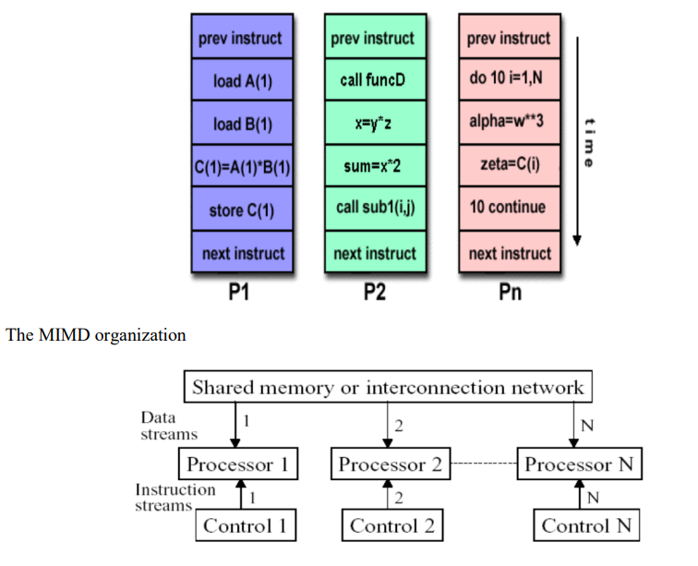
Contd…
MIMD
  Advanced parallel architecture
  Multiple cores operate on multiple data streams, each executing independent instructions
  Multi-core processors and distributed computing systems

Slide 19
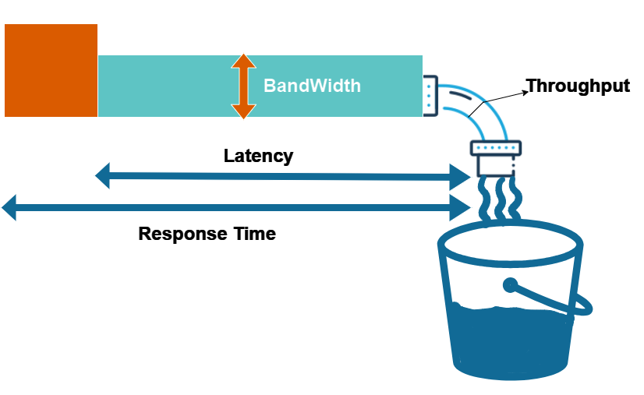
Enhancing Computational Efficiency: Key Objectives
At the architectural level, significant advancements have been made to accomplish the following goals:
  Reduce Latency: Minimizing the time taken for an operation to start and complete
  Enhance Bandwidth: Increasing the volume of data that can be processed per unit of time
  Increase Throughput: Maximizing the number of operations executed within a given timeframe

Slide 20
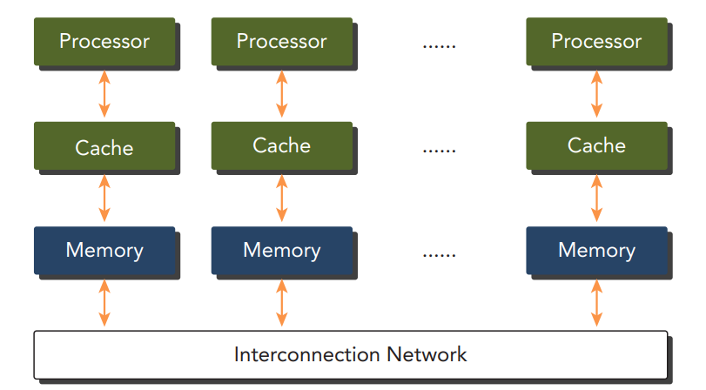
Classification of Computer Architectures by Memory Organization
Multi-node with distributed memory
  Many processors, each with local memory, communicate over a network
  Suitable for clusters

Slide 21
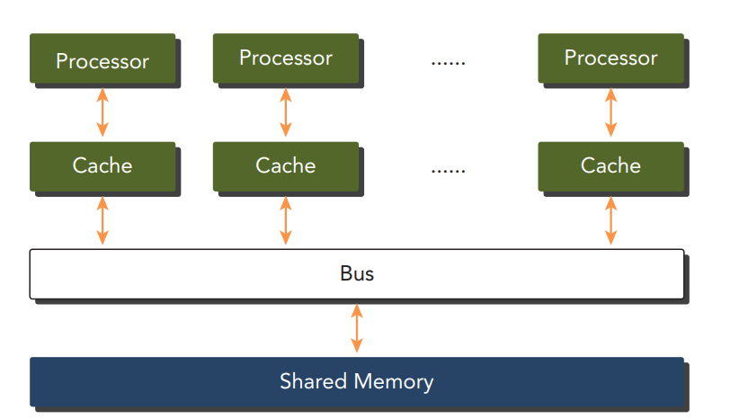
Contd…
Multiprocessor with Shared Memory
  Multiple processors sharing a common memory space, enabling direct data access and faster inter-processor communication

Slide 22
Heterogeneous Computing
Homogeneous Computing
  Involves one or more processors of the same architecture to execute applications
  In these systems, all processing units are identical and perform the same tasks in a similar manner
  Developers can write programs that assume all processors behave identically, leading to simpler software design
Heterogeneous Computing
  Utilizes a variety of processor architectures to execute applications, allowing tasks to be assigned to the most suitable architecture for performance improvements
  Systems can include CPUs, GPUs, FPGAs, and other specialized processors, each optimized for specific tasks
  Programming for heterogeneous systems can be more complex as developers must manage different architectures and ensure efficient task distribution

Slide 23
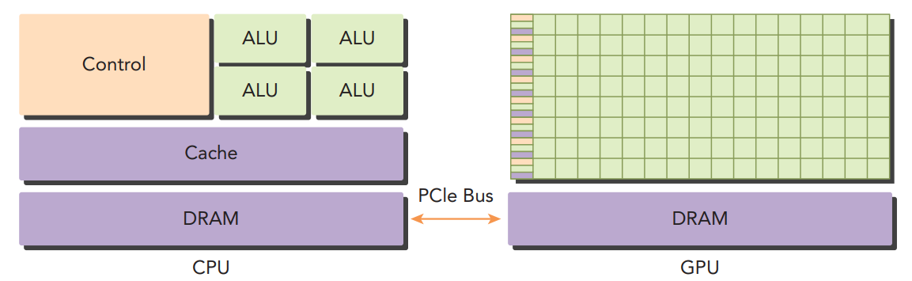
Heterogeneous Architecture
Terminology:
    Host: CPU
    Device: GPU
    PCIe: Peripheral Component Interconnect Express

Slide 24
End of Lecture 3

